Slide 1
Objective
Create model to train and test mask detection with less computation power and time

Slide 2
Face Mask Detection
Under the kind guidance of : Rajitha B Ma’am
By CS-12 :
Abinash Murmu,
Aditya Satish Mantri,
Beri Prasanth
Gaurav Bansal

Slide 3
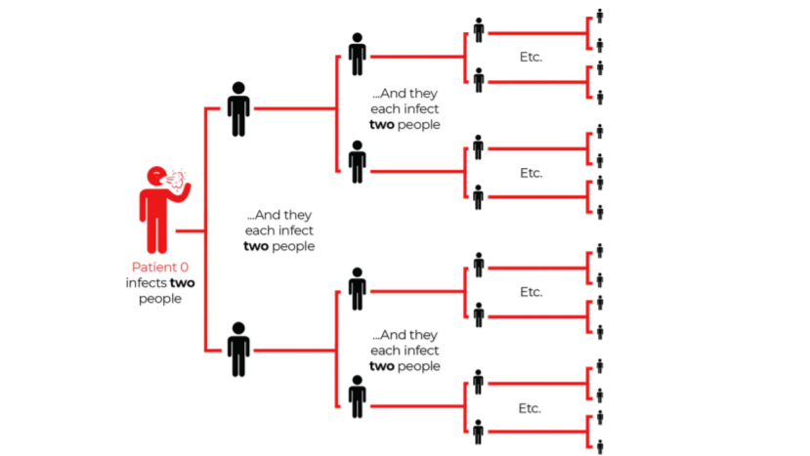
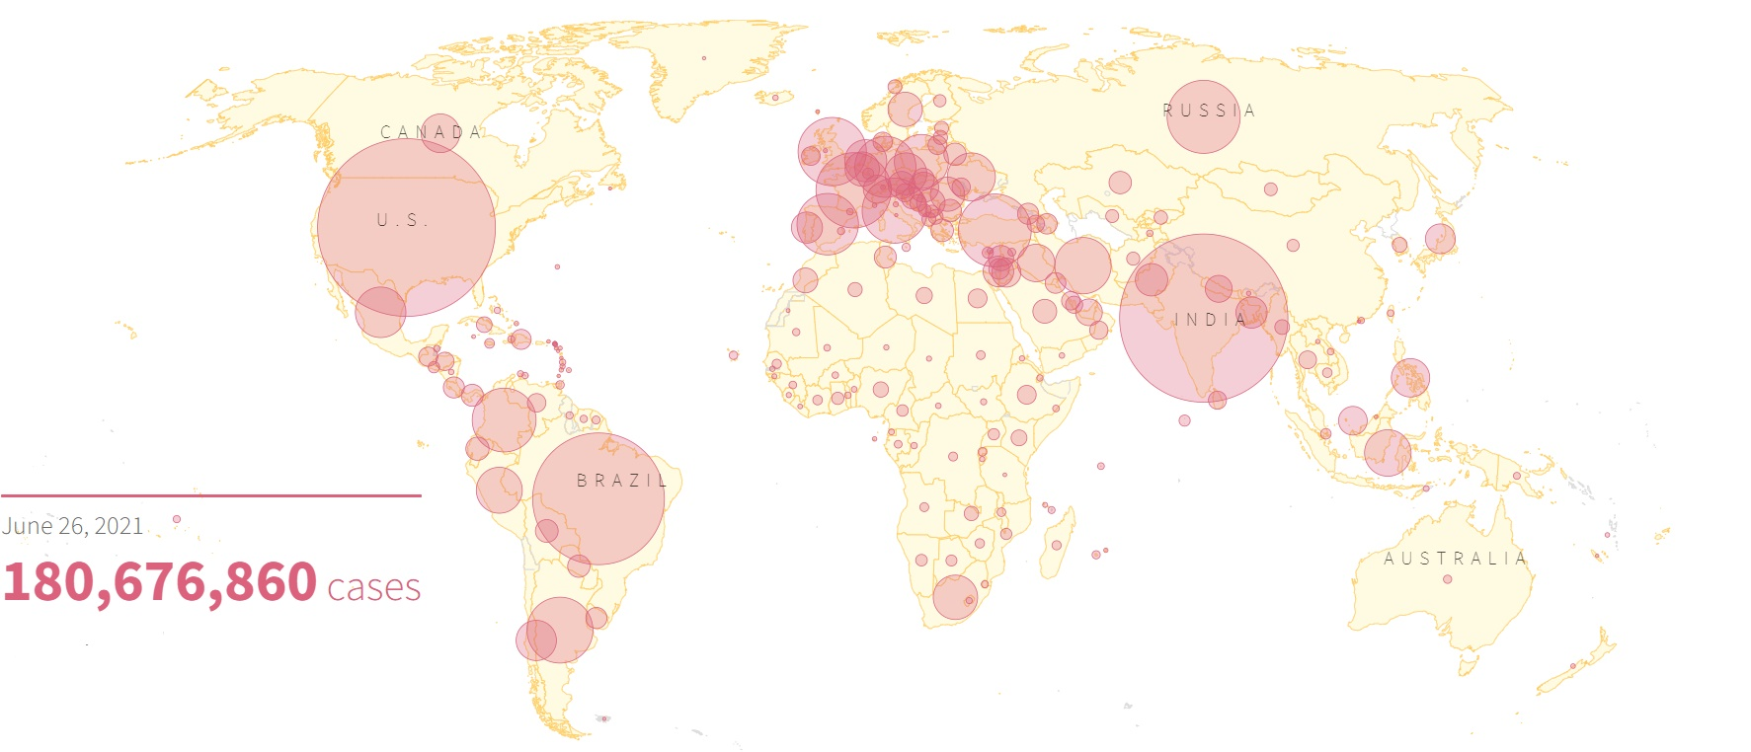
WHY?
More than five million cases were infected by COVID-19 in less than 6 months across 188 countries
Rules and laws were developed as an action to the exponential growth in cases and deaths
The process of monitoring large groups of people is becoming more difficult.

Slide 4
Requirements
Camera : For live analysis (photos may suffice)
Software :
Python Interpreter
Libraries:
Keras : Library for implementing neural networks
Sklearn : High-Level library upon the Keras library for concise implementation
MatPlotLib : For plotting analysis

Slide 5
Steps :
Preprocessing data
Training on data
Final execution

Slide 6
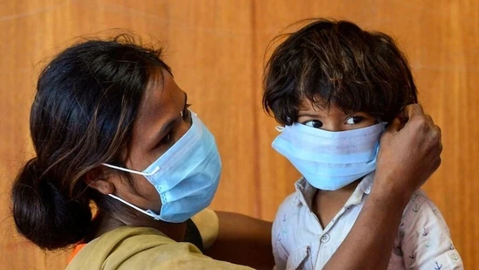
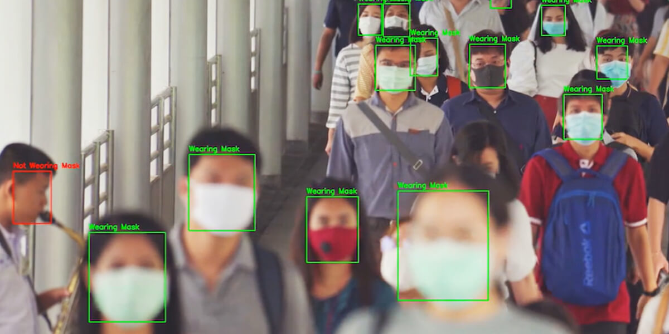
Data Preprocessing
Standardize the resolution of image dataset
Label or ‘divide’ the dataset. Here the labels are ‘masked’ / ‘unmasked’
Conversion of data to suitable format.
As neural networks don’t directly use raw binary images. It needs to converted to ‘numpy’ array.

Slide 7
What if data set is small?
Create ‘augmented data’
Augmented Data : Randomly change the visual parameters of original dataset to virtually create ‘new’ data

Slide 8
Training on Dataset

Slide 9
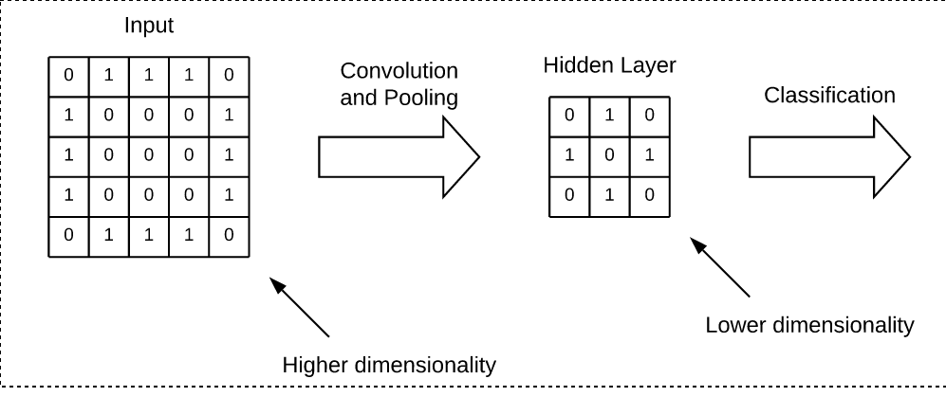
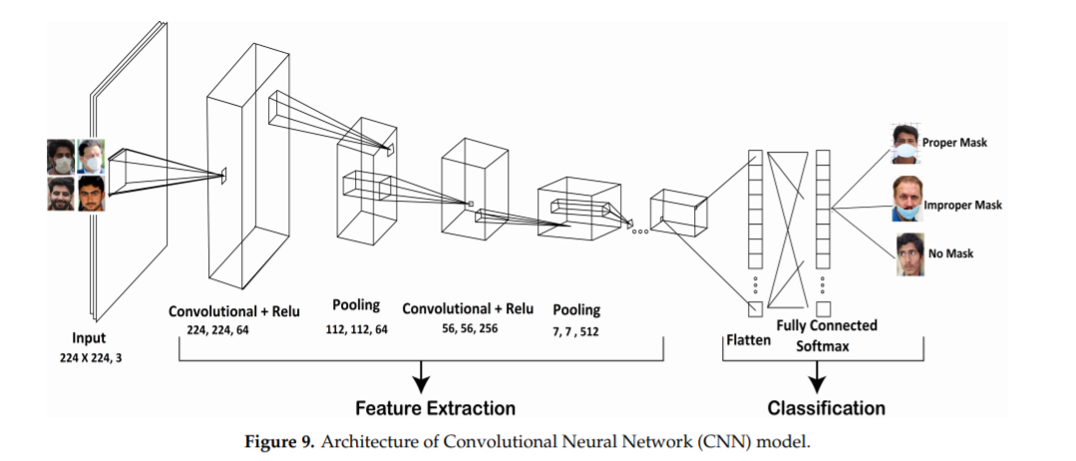
Brief representation of CNN

Slide 10
Steps
1.Load pre existing model
2.Create custom model upon it
3.Feed dataset
This method is called transferred loading.
We use a pre trained model to improve training time as model need not be created from scratch. The pre trained model in this case being the ‘imagenet’ model from MobileNet CNN library.
Why this approach is used?
Mask being a relatively non complex image, no errors have been reported using pre trained models.
Drastic improvements were reported using this method.

Slide 11
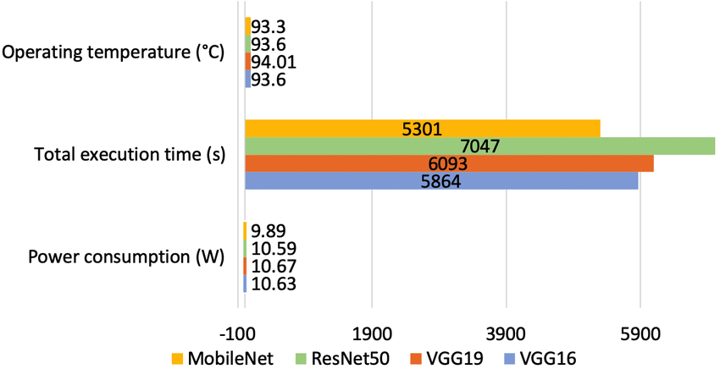
Why we chose MobileNet CNN Library?
Performance comparison with other CNN models :
It was designed to computationally light
The author Andrew G. Howard, of Google Research team describes it as :
“Family of mobile first computer vision model”

Slide 12
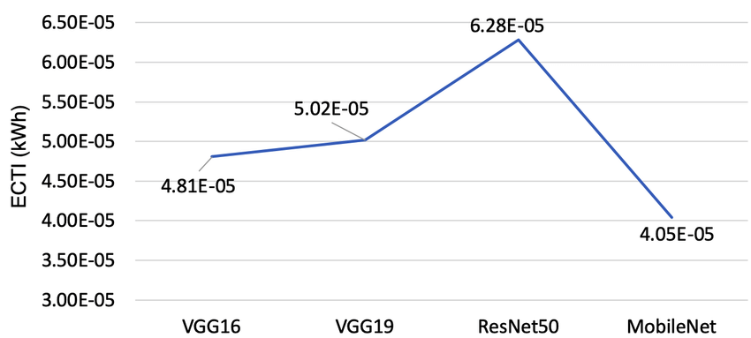
Comparison of power consumption

Slide 13
Parameters of the custom model :
Pooling
Flattening
Training Function or Hidden activation Function.
Classification Function

Slide 14
Step 1 : Setting Pooling

Slide 15
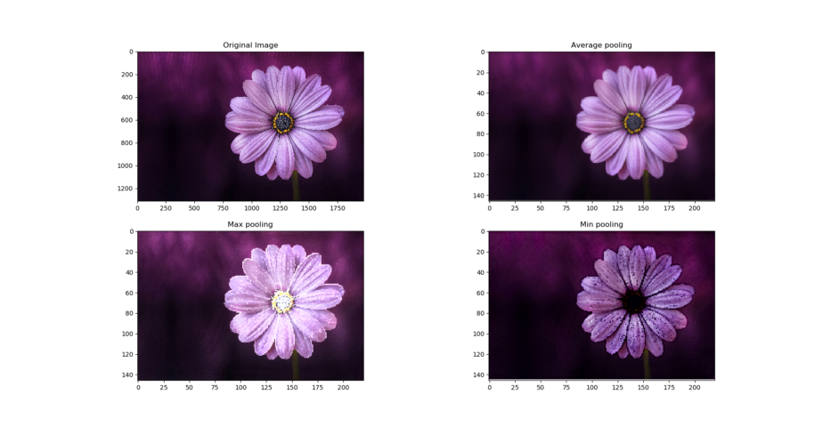
Various Pooling techniques

Slide 16
Why average pooling?
As the previous example showed that the image was ‘smooth’ out in average pooling.
This is desirable when the object to be classified is less detailed or ‘sharp’. Think about recognising a specific fish in a tank. It requires pooling without losing details.
The object in our case is a mask. Which is less detail intensive. Hence average pooling is used.

Slide 17
Step 2 : Set Flattening

Slide 18
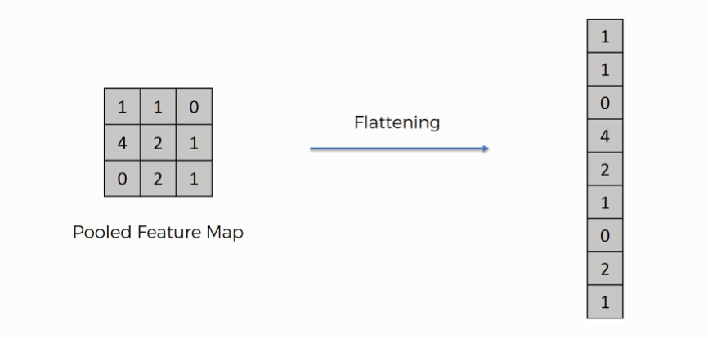
Flattening
Reduce the ‘dimensionality’ of the dataset. Not necessary but helps in reducing memory while dealing with hundreds of images.

Slide 19
Step 3 : Set Activation function for
Hidden Layer

Slide 20
Relu
It is an activation function.
Given an input. A neuron either ‘fires’, if output is within appropriate threshold or does nothing. That output is generated from the activation function.
Why Relu?
It reduces the vanishing gradient problem which is a problem found in many standard activation functions like the sigmoid function.
.

Slide 21
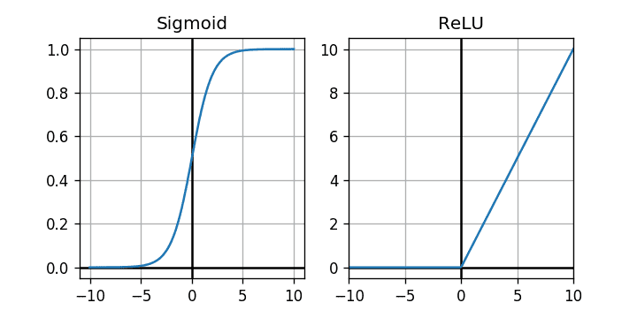
What is vanishing gradient problem?
The output from the activation function gets ‘vanishingly’ small so that the neurons do not fire at all. Forcing the network to repeat calculation multiple times.
Notice that the sigmoid functions growth is very very low as input value increases.

Slide 22
It is not a big problem if sufficient computation power is present
but that is not the case here.

Slide 23
Step 4 : Set Activation Function for final classification layer

Slide 24
Softmax()
Reduces the final vector to a list of probabilities.
Why probabilities involved?
Observe that there are two states. Either masked or no masked. Both are mutually exclusive.
Hence probabilities can be used to calculate the ‘positive’ part using the ‘negative’ part
Therefore this function is used in the final layer for determining the output.

Slide 25
Further Improvement
Reduce overfitting : Used inbuilt dropout() function to reduce overfitting.
Adjusting learning rate : Reduce learning rate to improve accuracy

Slide 26
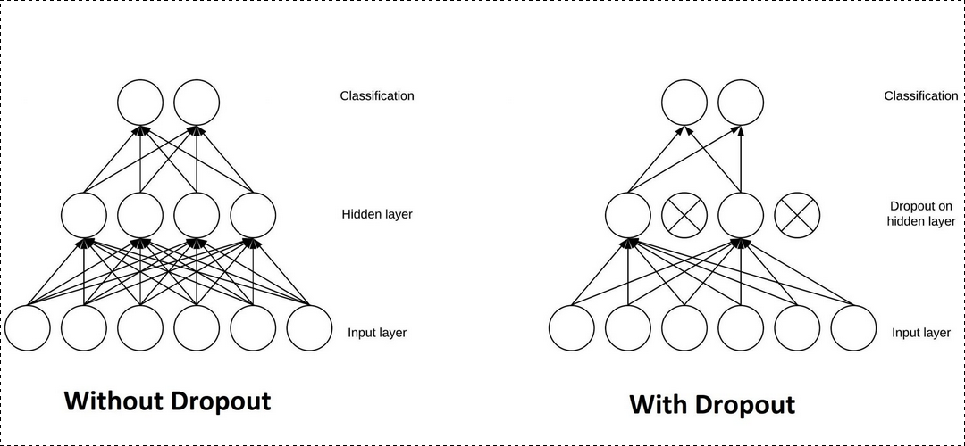
Observe the difference in no of ‘links’

Slide 27
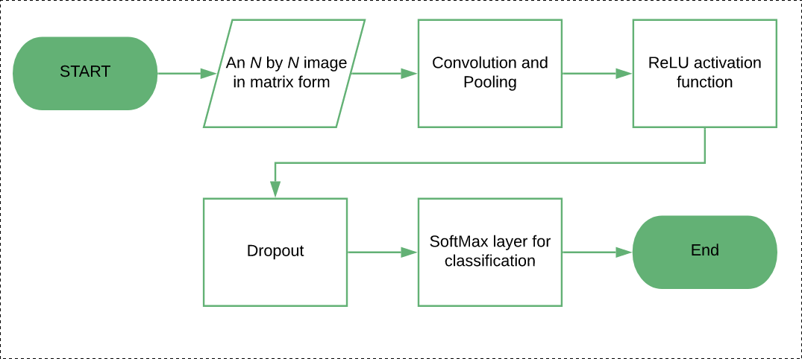
Summary

Slide 28
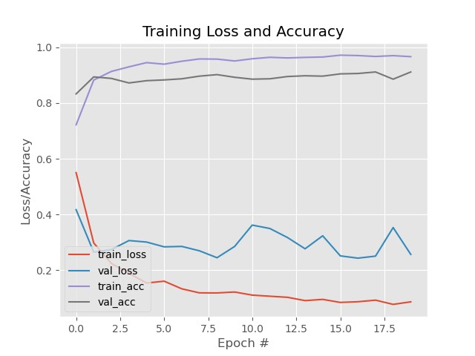
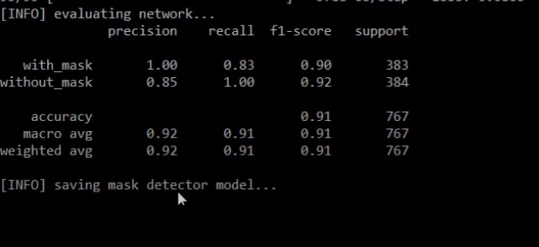

Slide 29
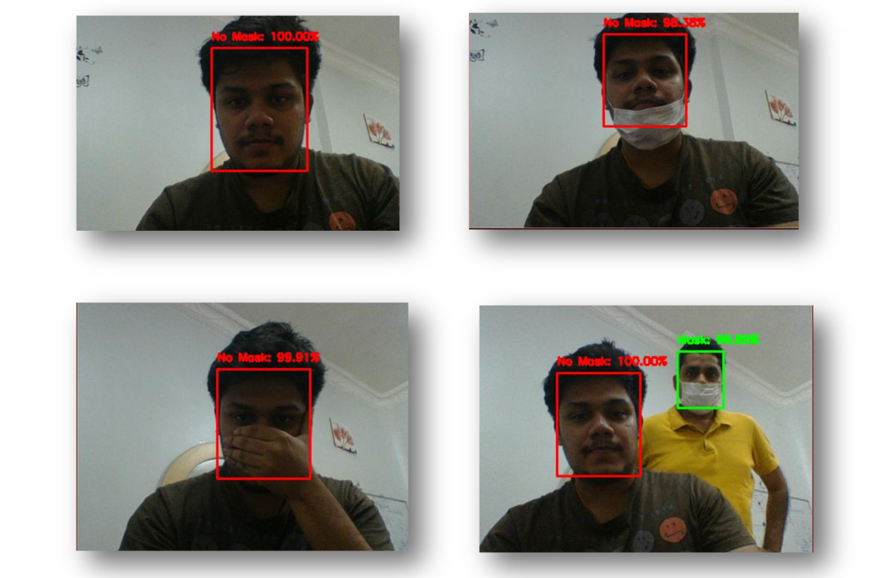
Result
Optimal results were observed.
No false positives were reported under our experiments.
Obstruction of mouth and nose was reported accurately

Slide 30
And….?
In addition to the negative or positive result.
We get a % sign
It provides a visually intuitive way to analyse data
Improves analysis and adjustment without delving deep into the code itself

Slide 31
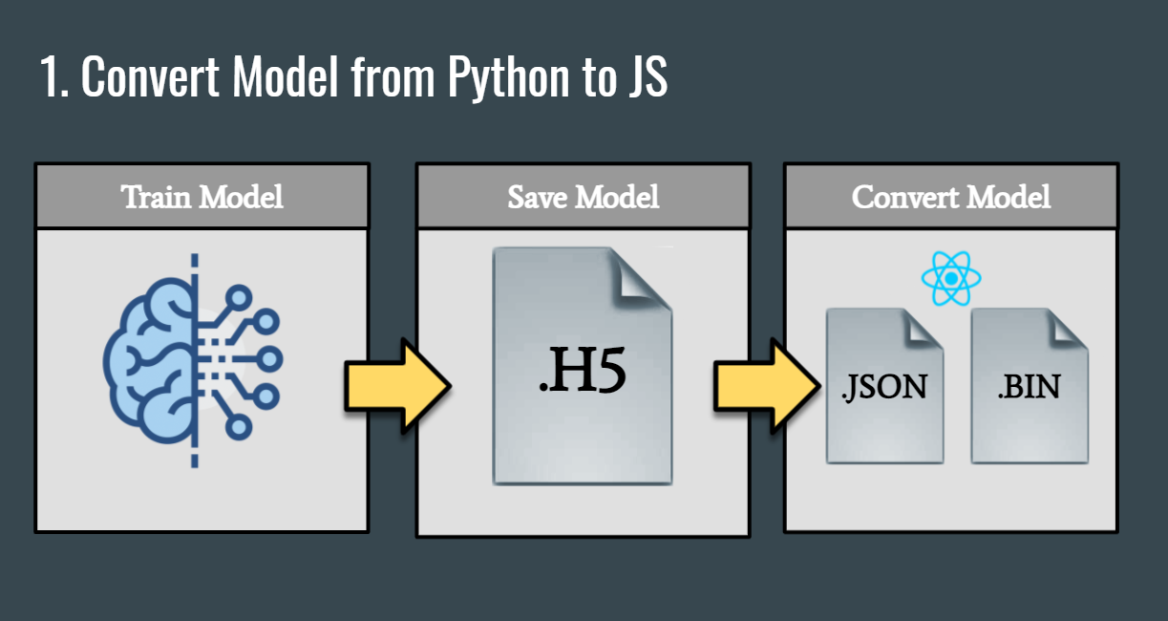
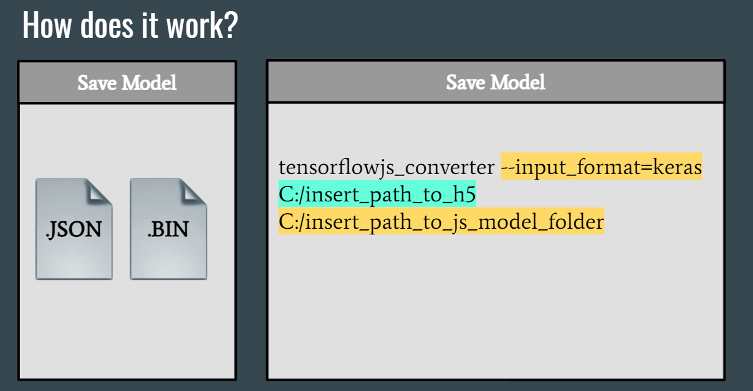
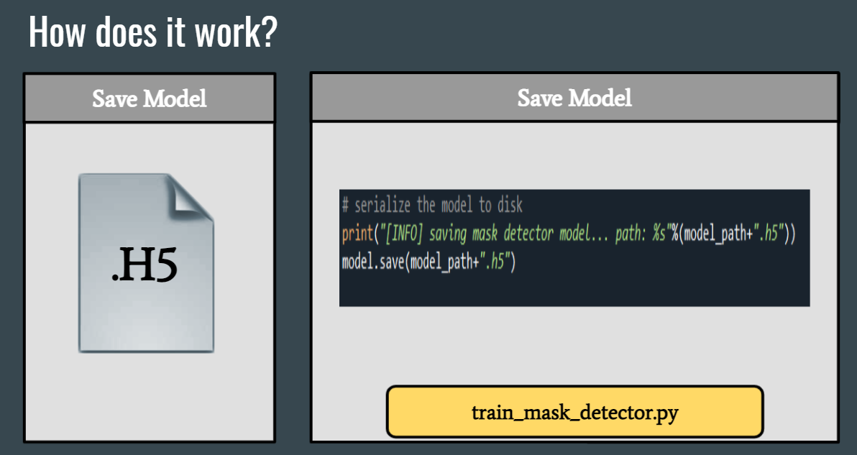
INTEGRATION WITH WEB DEV

Slide 32
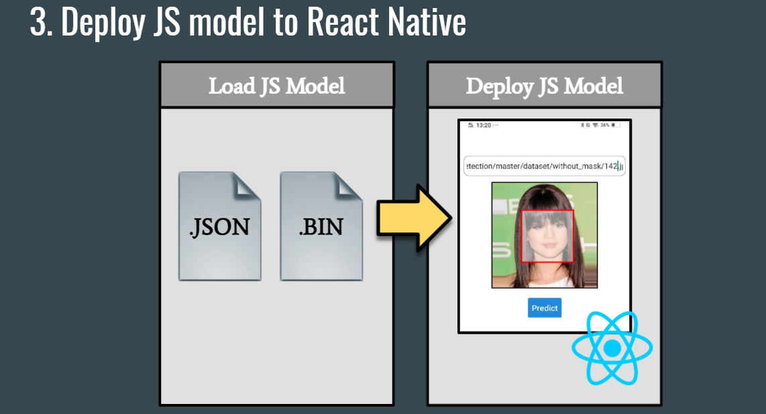
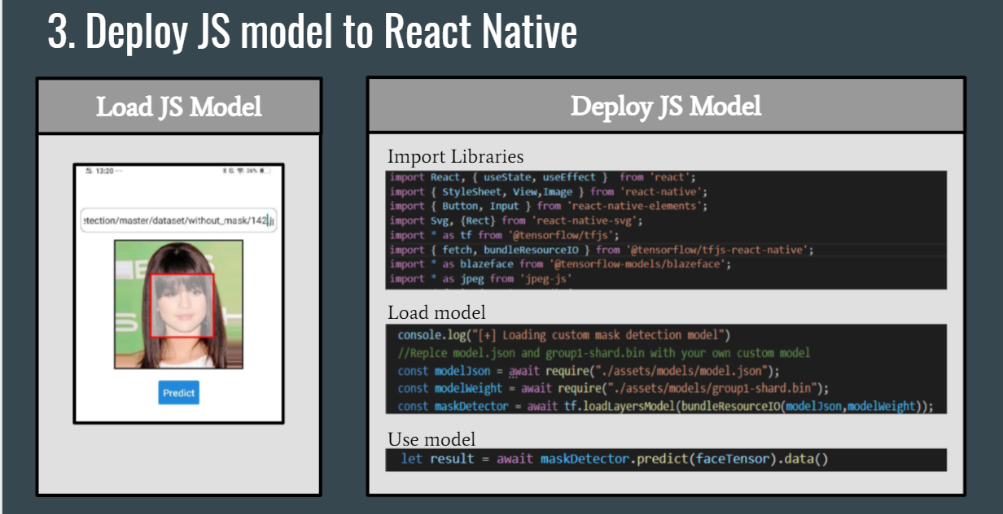
INTEGRATION WITH WEB DEV

Slide 33
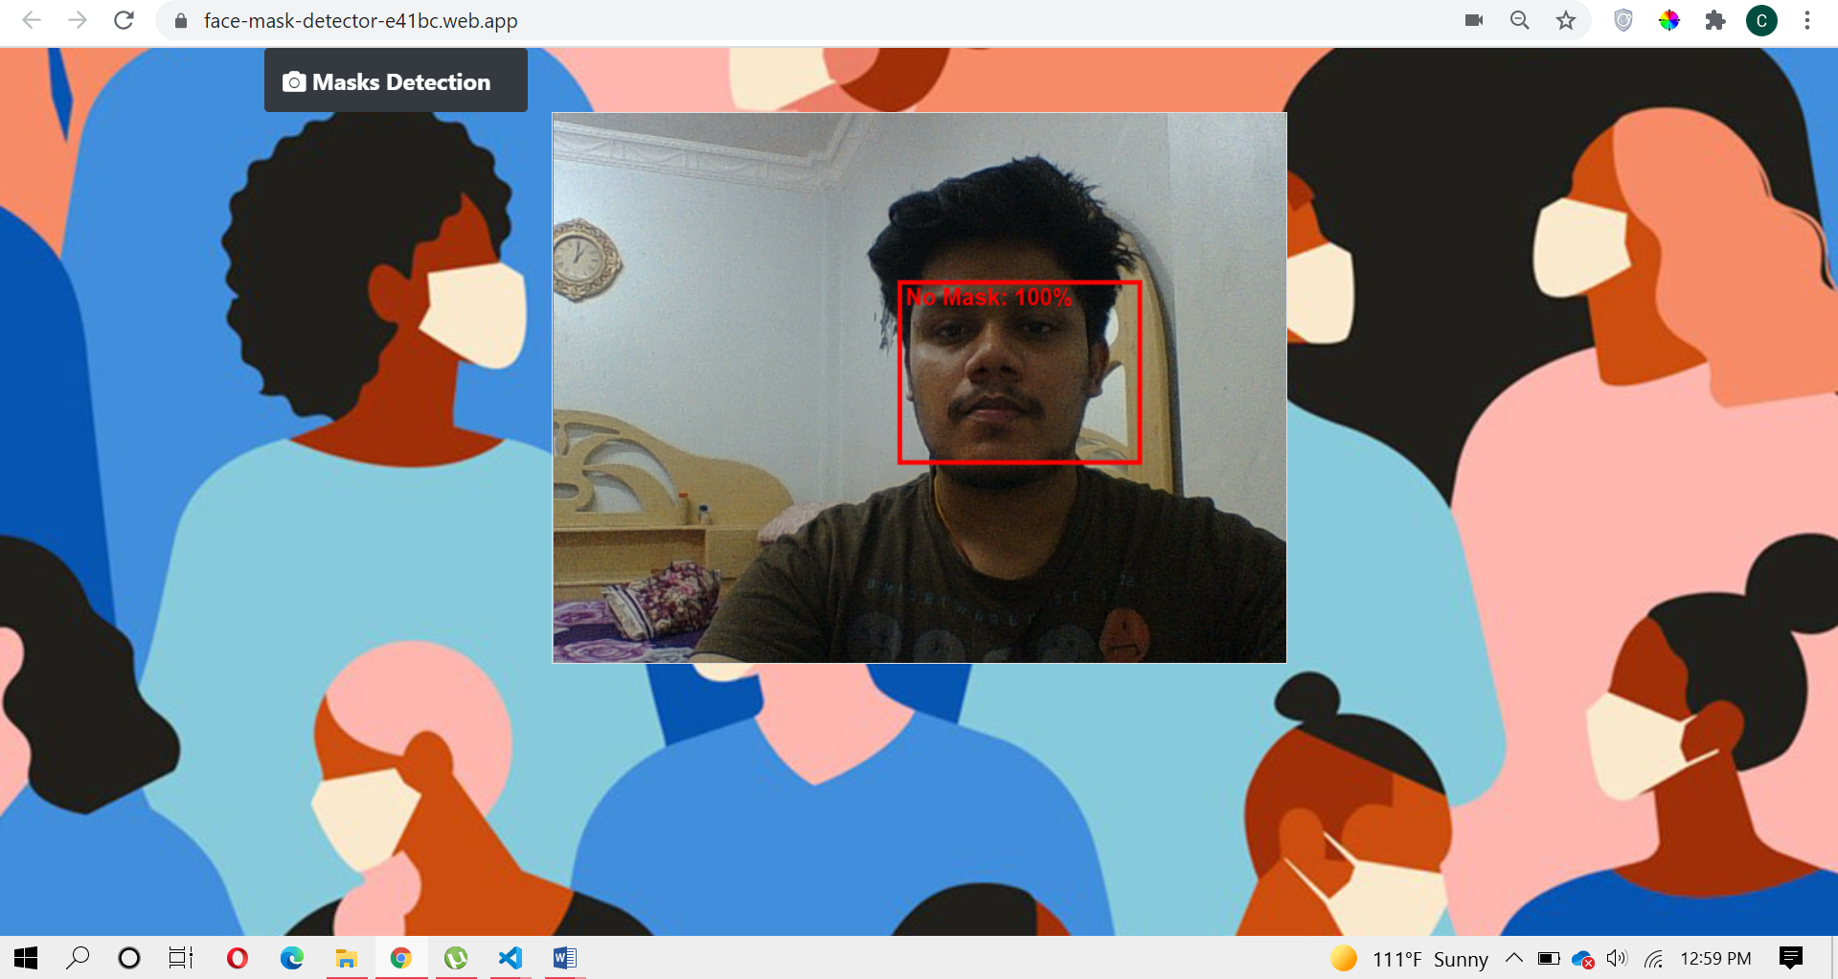
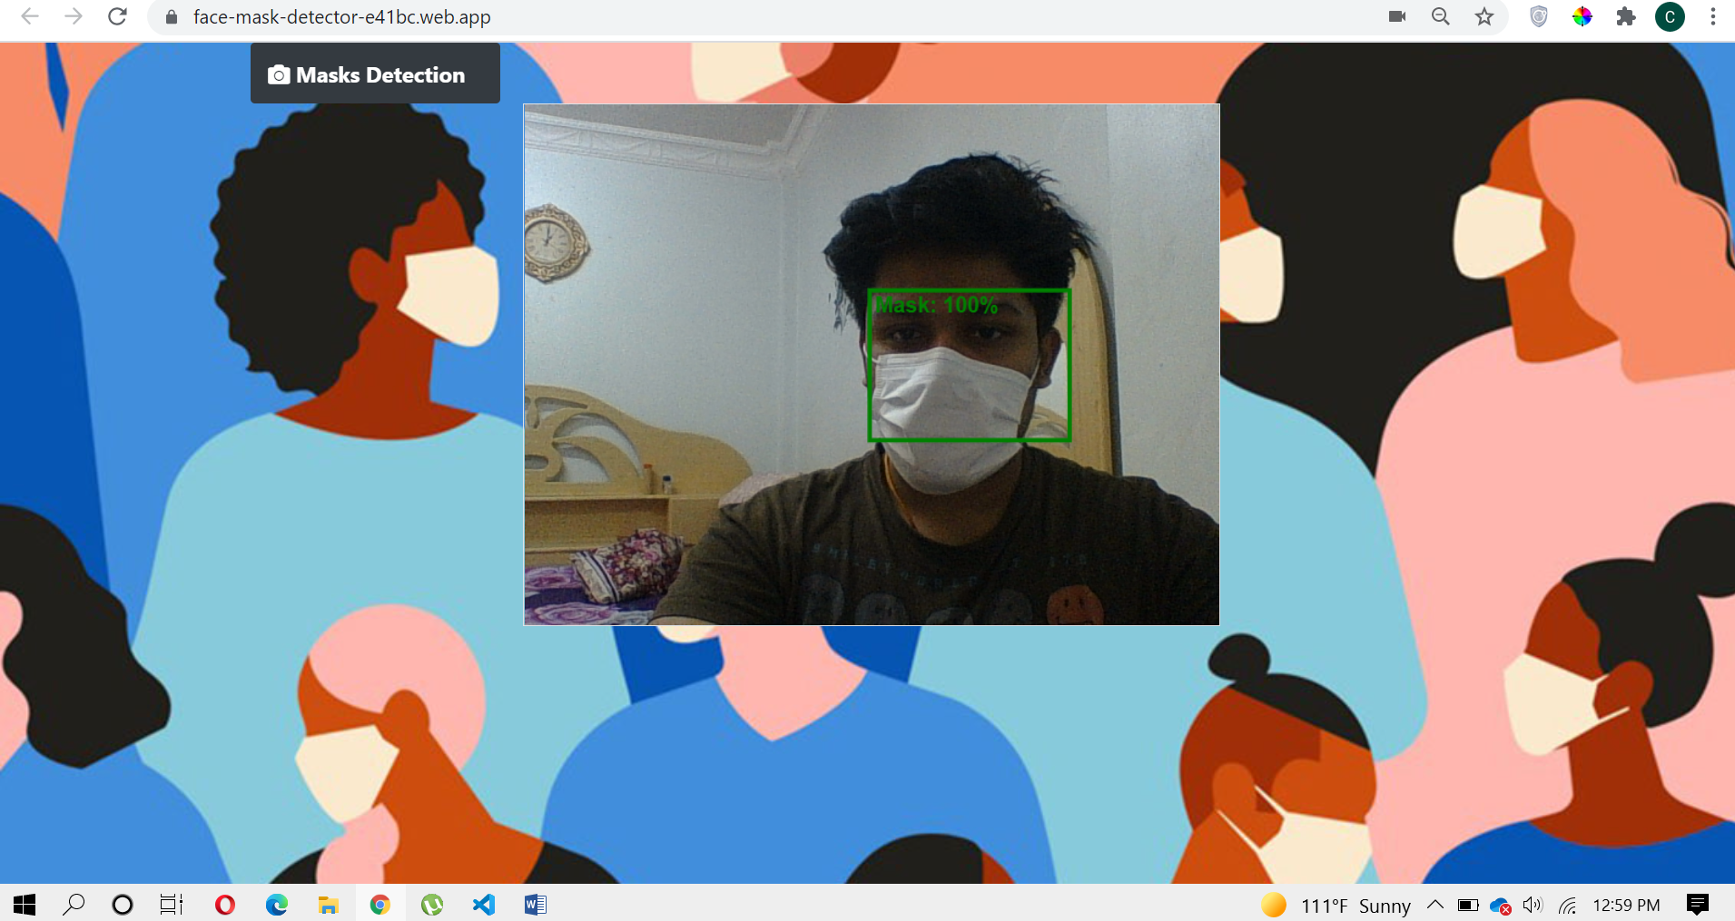
INTEGRATION WITH WEB DEV
Link : https://face-mask-detector-e41bc.web.app

Slide 34
What is the future?
The best next step is to further optimize the problem to not only execute but train datasets on mobile and embedded devices.
Implement face Recognition whether person is wearing Mask or not.

Slide 35
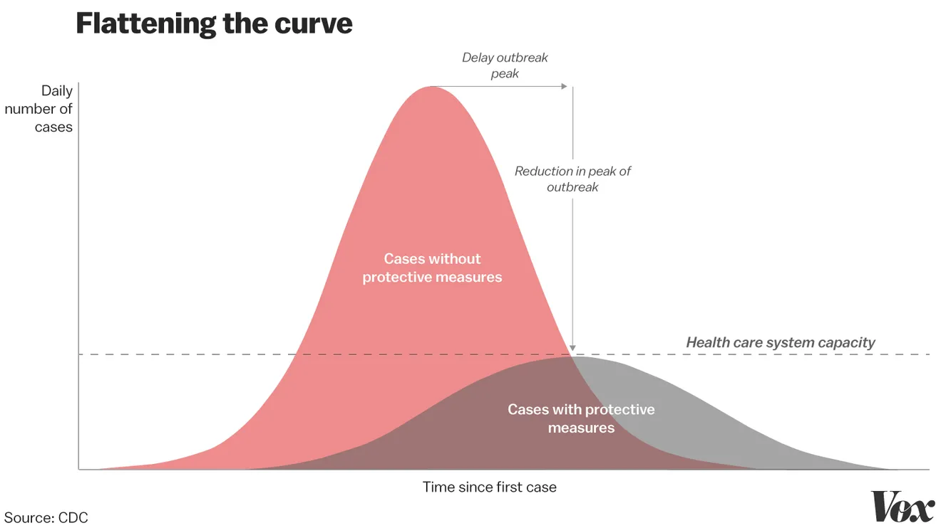
CONCLUSION

Slide 36
Thank You!

